Slide 1
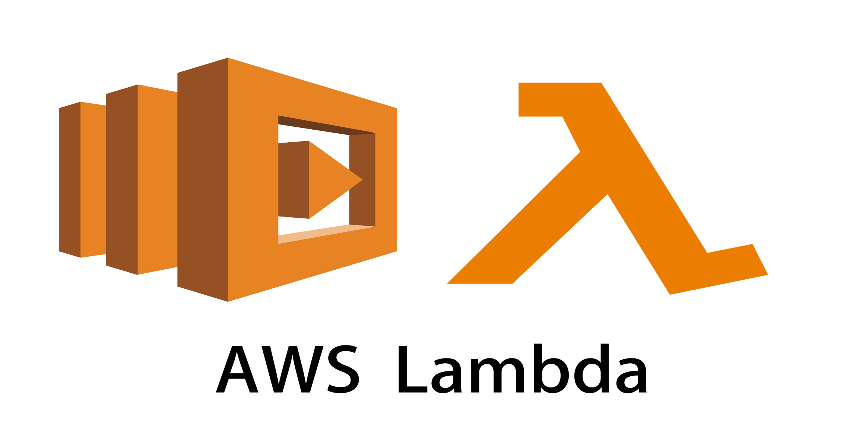

Slide 2
Aws lambda
AWS Lambda is a Compute Service that let’s you run code without provisioning or Managing Servers.
With AWS lambda , you can run code for Virtually any type of application or backend Services-all with zero Administration.
AWS Lambda manages all the administration it manages-
Provisioning and capacity of the compute fleet that after a balance of memory , CPU , network and other Resource.
Server and O.S Maintainenace .

Slide 3
3. High availability and automatic scaling.
4. Applying security patches
5.Deploying your code
6.Monitoring and logging your Lambda Functions.
7.AWS Lambda Runs your code on a high availability Compute infrastructure.

Slide 4
AWS Lambda executes your code only when needed and scales Automatically from a few request per day to thousands per second.
You pay only for the Compute time you consume .
No Charge When your code is not running.
All you need to do is supply your code in the form of one or more Lambda functions to AWS Lambda, in one of the language that AWS Lambda supports( Currenty Nodejs , Java , Powershell , C# , Ruby , Pyhon & Go) and the service can run the code on your behalf.
Typically the lifecycle for AWS Lambda application includes authoring code , deploying code to the AWS lambda and then Monitoring and troubleshooting.

Slide 5
This is in exchange for flexibility which means you cannot log into the Compute instances or Customize the operating system or language Runtime.
If You do want to manage your own Compute , you can use EC2 or Elastic Beanstalk.

Slide 6
How Lambda Works?
First you upload your code to lambda in one or more lambda function.
AWS Lambda will then execute the code in your behalf.
After the code is invoked , Lambda automatically take care of provisioning and managing the required Server.

Slide 7
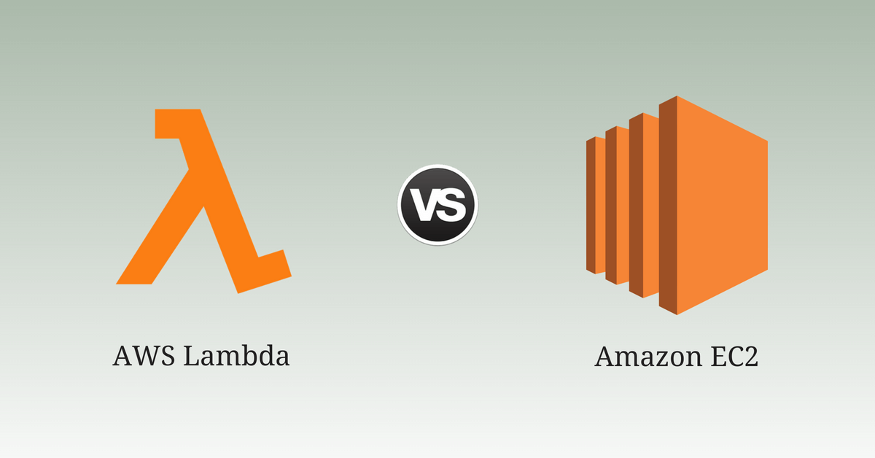

Slide 8
AWS LAMBDA VS AWS EC2
AWS Lambda is a platform as a service
Supports only limited languages.
Write your code & push the code into AWS Lambda.
You cannot log into compute instances , choose Customized OS or language Platform.
AWS EC2 is a Infrastructure as a service
No environment restrictions you can run code any code or language.
For the first time in EC2 you have to to choose the O.S and install the software required and then push your code.
You can Select Variety of OS , instance types , network & Security Patches, RAM & CPU etc.

Slide 9
Important TERMS
Function : A function is a resource that you can invoke to run your code in AWS Lambda. A function has a code that processes events.
Runtime: Lambda runtime allows functions in different language to run in the same base execution environment.
Event: Event is a JSON formatted document that contains data for a function to process.
Trigger: An AWS Service such as Amazon SNS or a custom Service that trigger your functions and executes its logic.

Slide 10
Sample python CODE
import boto3
region = 'us-east-2'
instances = ['i-05ae0a328c876b17b']
ec2 = boto3.client('ec2', region_name=region)
def lambda_handler(event, context):
ec2.stop_instances(InstanceIds=instances)
print(‘stop your instances: ' + str(instances))

Slide 12

AWS Elastic Beanstalk
AWS Elastic Beanstalk is an easy-to-use service for deploying and scaling web applications and services
AWS Elastic Beanstalk Overview • Elastic Beanstassslk is a developer centric view of deploying an application on AWS
It uses all the component’s we’ve seen before: EC2, ASG, ELB, RDS, etc…
In Elastic Beanstalk we still have full control over the configuration
Beanstalk is free but you pay for the underlying instances

Slide 13
Elastic Beanstalk
Managed service
Instance configuration / OS is handled by Beanstalk Deployment strategy is configurable but performed by Elastic Beanstalk
Just the application code is the responsibility of the developer
Three architecture models:
Single Instance deployment: good for dev
LB + ASG: great for production or pre-production web applications
ASG only: great for non-web apps in production (workers, etc..)

Slide 14

Elastic Beanstalk
Elastic Beanstalk has three components
• Application
• Application version: each deployment gets assigned a version
• Environment name (dev, test, prod…): free naming
You deploy application versions to environments and can promote application versions to the next environment
Rollback feature to previous application version
Full control over lifecycle of environments

Slide 15
Elastic Beanstalk
Support for many platforms:
• Go • Java SE
• Java with Tomcat
• .NET on Windows Server with IIS
• Node.js
• PHP
• Python
• Ruby
• Packer Builder
Single Container Docker • MulticontainerDocker • Preconfigured Docker

